Slide 1

Linear Integrated Circuits EE-411 L1
Dr. Syed Arsalan Jawed
Associate Professor of Practice
Office Hours : W-301, Tuesday/Thursday : 1600-1700
September 02-04, 2025
H-505
!پھربرق فروزاں ہےسر وادی سینا ، اۓدیدہ بینا
The flame of illumination set ablaze…. O’ the beholder of sight!

Slide 2
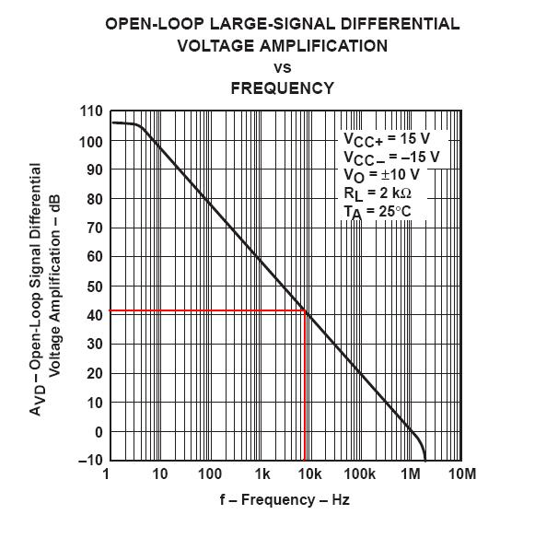
Opamp Based Simple Circuits
The most famous Opamp – LM741
Very different from Ideal Opamp
Gain changes with frequency
Input offset currents of nanoAmps
Output current limit of 20mA
Supply limit of +-15V
How to practically use Opamp?
Negative Feedback.
Gain Desensitization

Slide 3
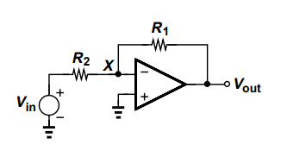
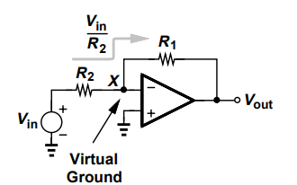
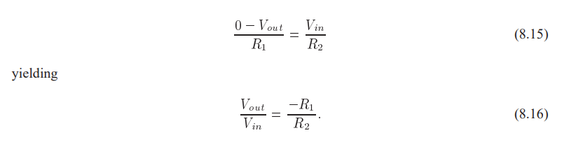
Inverting Amplifier

Slide 4
Issues with Inverting Amplifier
Inverting gain.
Input impedance = R2

Slide 5
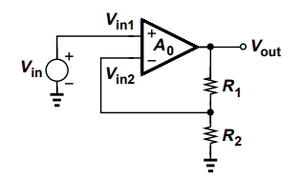
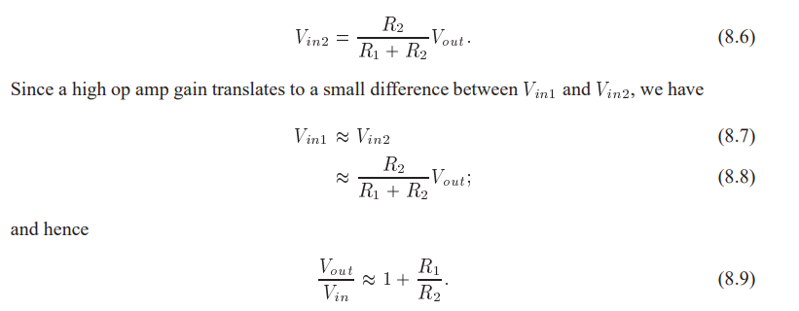
Non Inverting Amplifier
Rin= Infinity
Non inverting gain

Slide 6
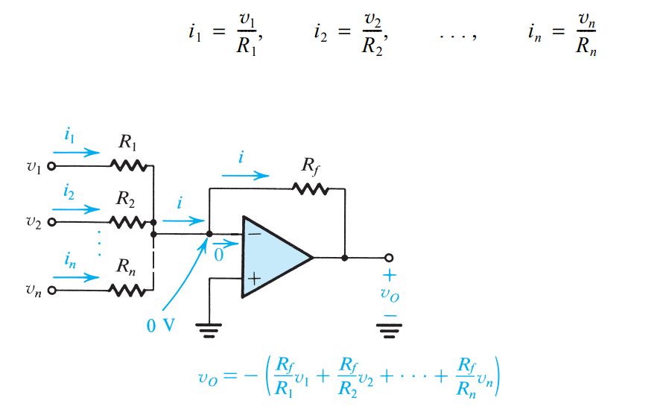
Weighted Summer

Slide 7
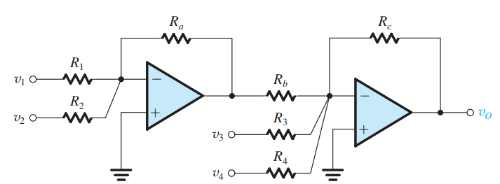

Class Example

Slide 8
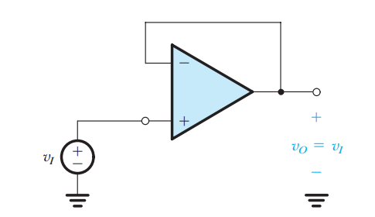

The Voltage Follower

Slide 9
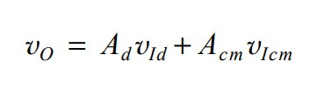

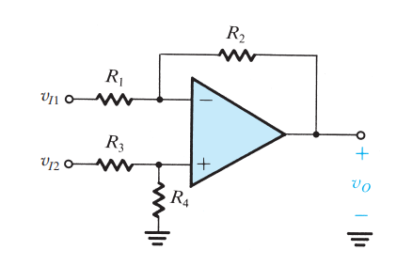




Difference Amplifiers
/home exercise

Slide 10
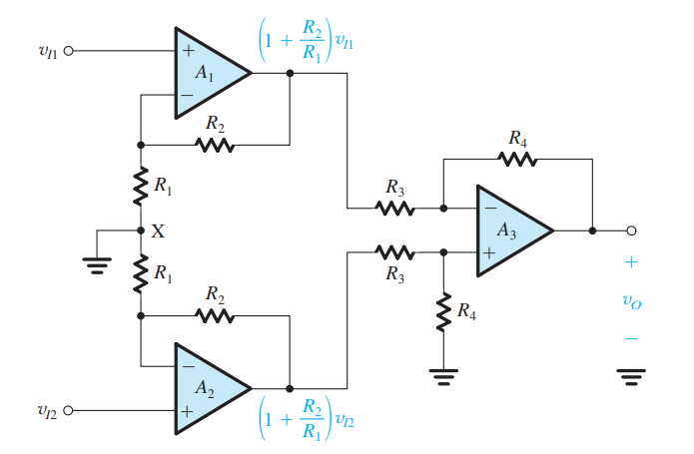

The Instrumentation Amplifier

